Slide 1
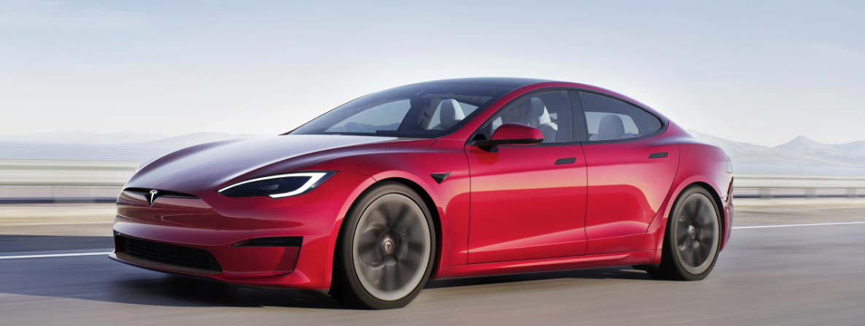
TESLA
A Recession-Proof Stock?
Using data analytics to predict EV stock value

Slide 2

Overview
Tesla designs and manufactures electric vehicles, battery energy storage from home to grid-scale, solar panels and solar roof tiles, and related products and services.
Need more text here? Or, a better overview.
TEAM:
TRACEY FITZPATRICK Tracey Fitzpatrick
CHERYL FARNSWORTH Cheryl Farnsworth
KELLY NICHOLS Kelly Nichols
HOLLY SMITH Holly Smith
note - ↑TESLA font, not super-readable. All caps vs regular case.
Yay or nay?
Notes:
Talk about:
Selected topic
Reason why we chose this topic

Slide 3








Source Data & Technologies Used
StockAnalysis.com
Kaggle
Google API (?)
tesla.com
polestar.com
We can make this 2 slides if needed.
Notes:
https://cleantechnica.com/2022/07/17/polestar-3-pricing-revealed-are-you-sitting-down/ : “Polestar, the all-electric brand from Volvo Cars [starts at $47,200] is taking direct aim at the Porsche Cayenne [starts at $150,000] in its bid to become a major manufacturer of electric automobiles.”

Slide 4
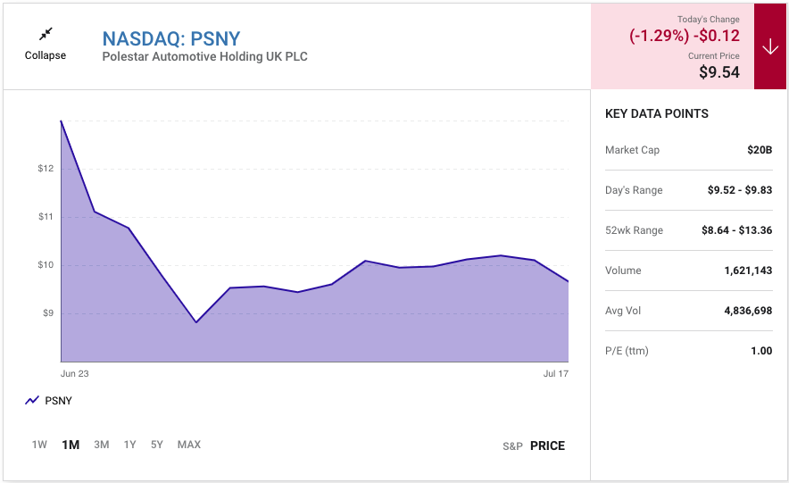
Polestar IPO: June 28, 2022
Notes:
https://www.fool.com/investing/2022/07/14/polestar-stock-psny-best-ev-stocks-tsla-stock/
https://www.media.volvocars.com › media › pressreleases:
Polestar will be ringing the opening bell at Nasdaq in New York City on June 28, 2022 to celebrate the company's public listing.

Slide 5
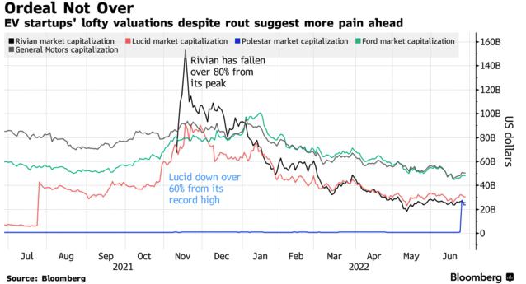
Part of the story - interesting
Polestar’s Lukewarm Debut Sends Troubling Signal for EV Makers
Inflation, slowing economy hurt appeal of unproven companies ‘Investors are going to have to revalue these EV names’
Notes:
https://www.bloomberg.com/news/articles/2022-06-28/polestar-ipo-s-meh-greeting-is-a-troubling-signal-for-ev-makers

Slide 6
Questions to answer
We'd like to capitalize on a down market in the next recession by investing in "Recession Proof IPOs". Specifically buying low and selling high. Our model will try to predict if such a thing exists based on prior IPO performance in the last recession.
Tesla stock 7/1/2012 – 7/1/2022
Notes:
Update

Slide 7
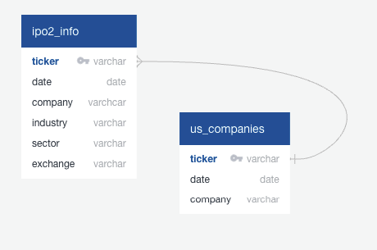
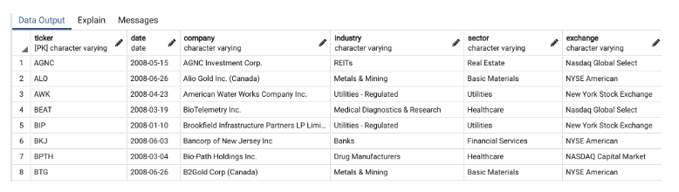
Data Exploration
These are stand-in pictures.
Must be updated.

Slide 8
Analysis

Slide 9
Results

Slide 10
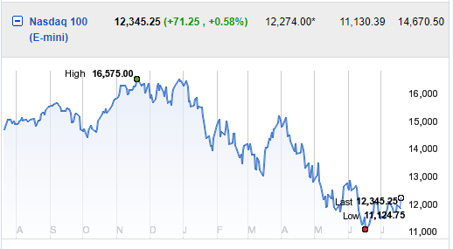
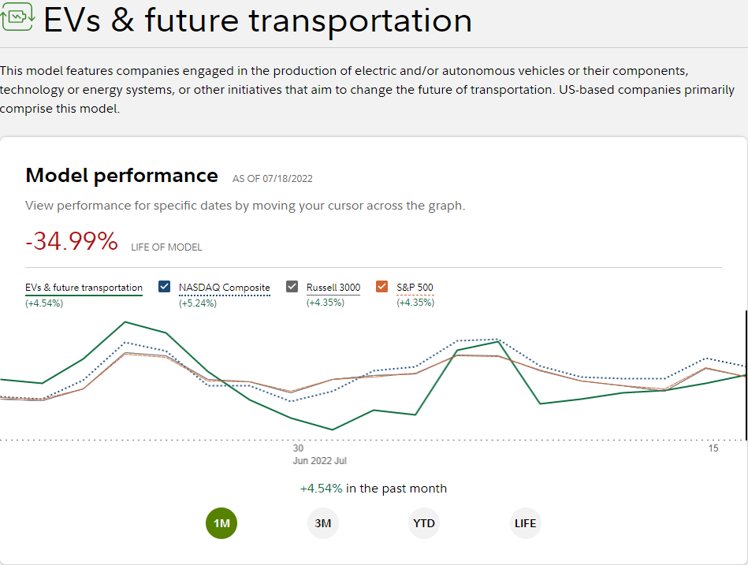
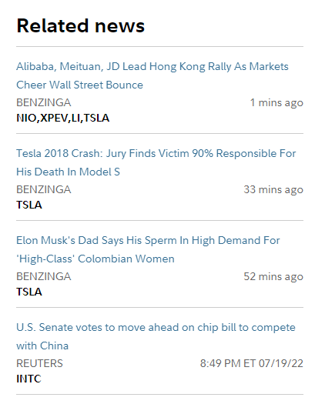
Dashboard
EV & Future Transporta-- tion Model – 1 Month
NASDAQ
Placeholder for stock ticker tape
Chart from Data Analysis
Data Analysis Info

Slide 11
Recommendations

Slide 12
What the team would have done differently

